Slide 1
Apple cake baking guide.
chatGPT, Dall-E and Robert Haase

Slide 2
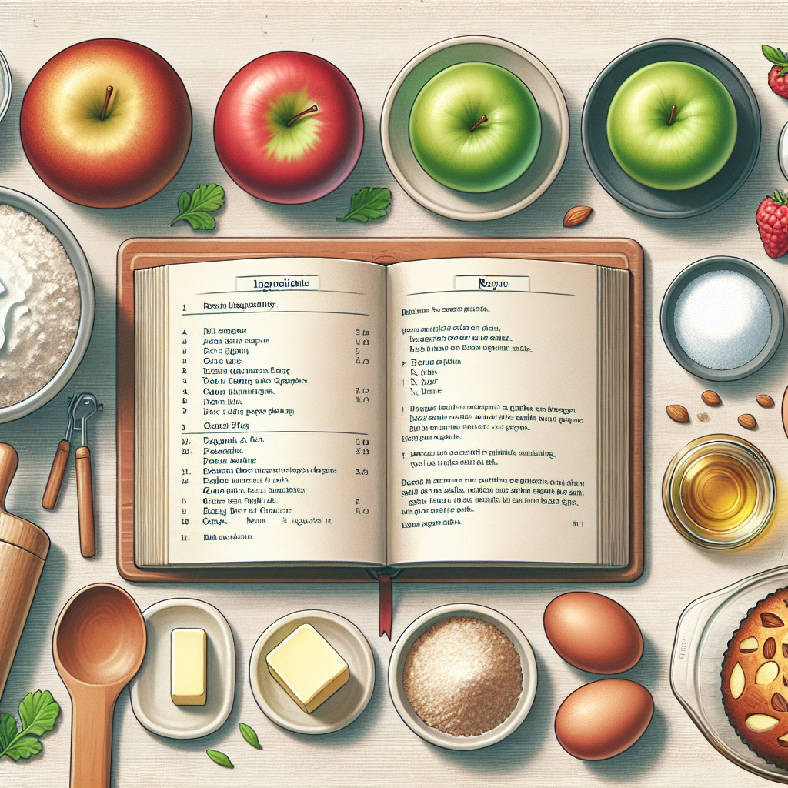
Apple cake ingredients needed.
To make a delicious apple cake, you will need the following ingredients:

Slide 3
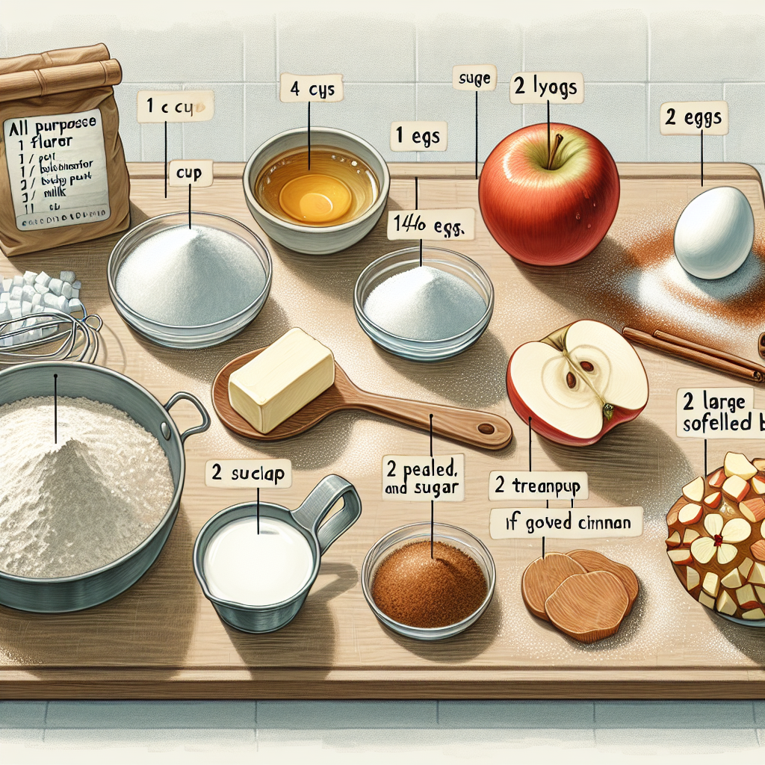
Apple Cinnamon Cake Ingredients
- 1 cup of all-purpose flour
- 1 teaspoon of baking powder
- 1/4 teaspoon of salt
- 1/2 cup of unsalted butter, softened
- 3/4 cup of sugar
- 2 large eggs
- 1 teaspoon of vanilla extract
- 1/4 cup of milk
- 2 large apples, peeled, cored, and chopped
- 1 teaspoon of ground cinnamon
- 2 tablespoons of brown sugar

Slide 4
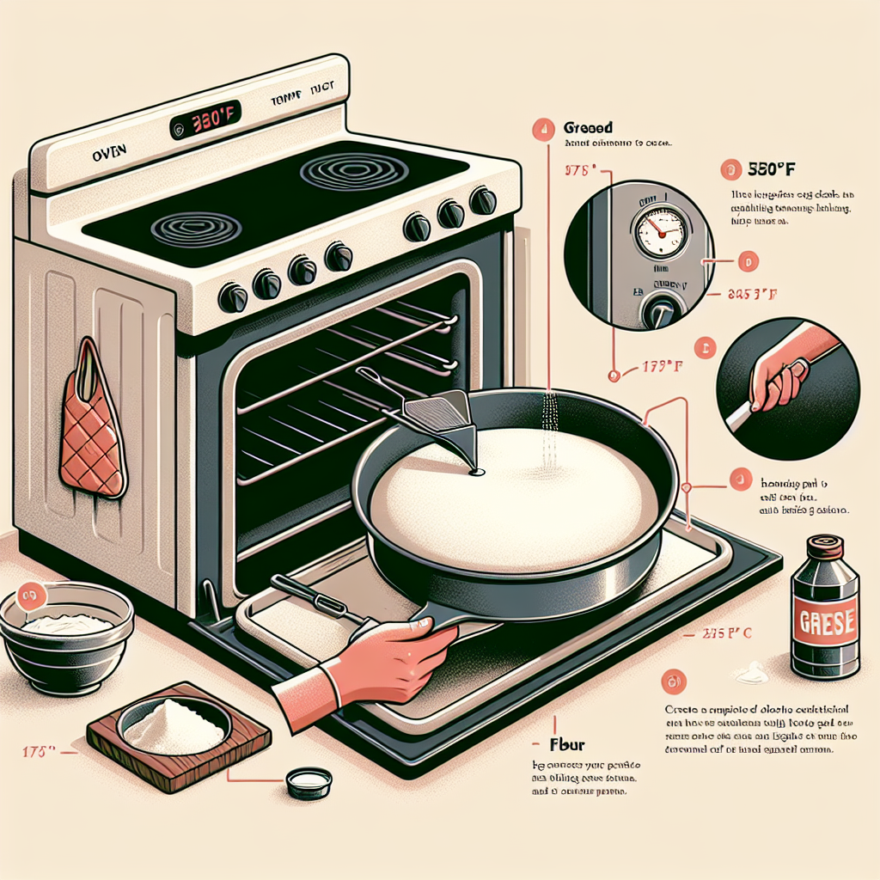
Preheat, grease, flour cake pan.
Preheat your oven to 350°F (175°C). Grease and flour an 8-inch round cake pan.

Slide 5
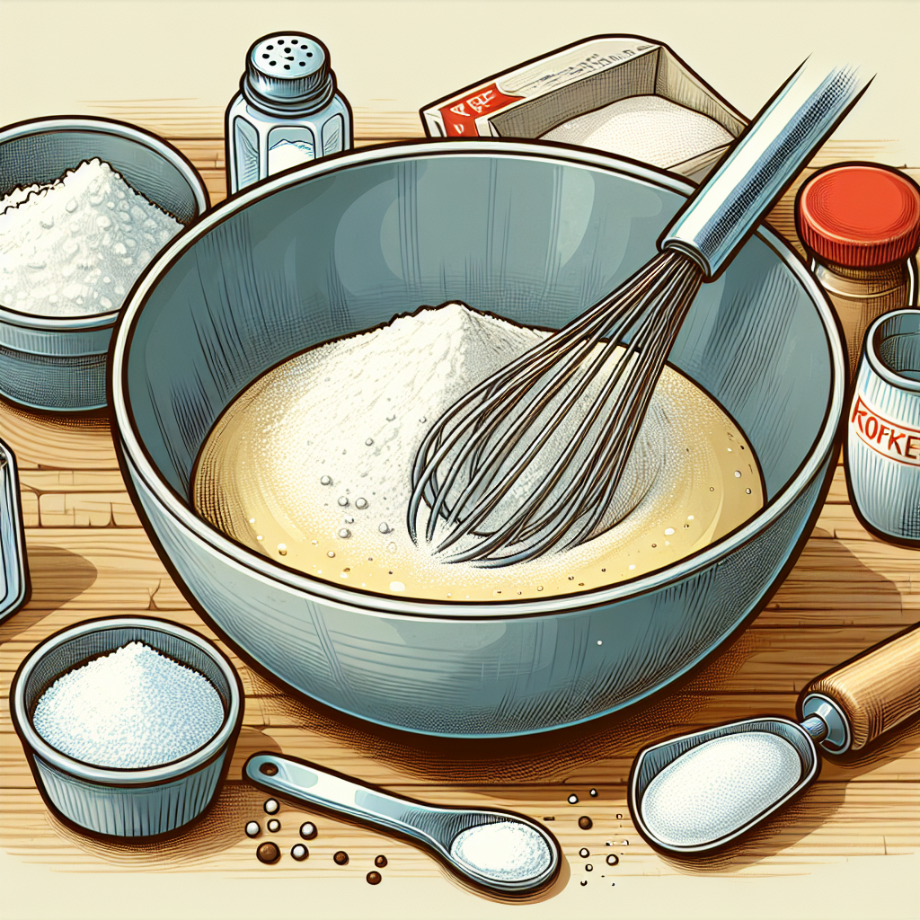
Mix flour, baking powder, salt.
In a medium bowl, whisk together the flour, baking powder, and salt. Set aside.

Slide 6
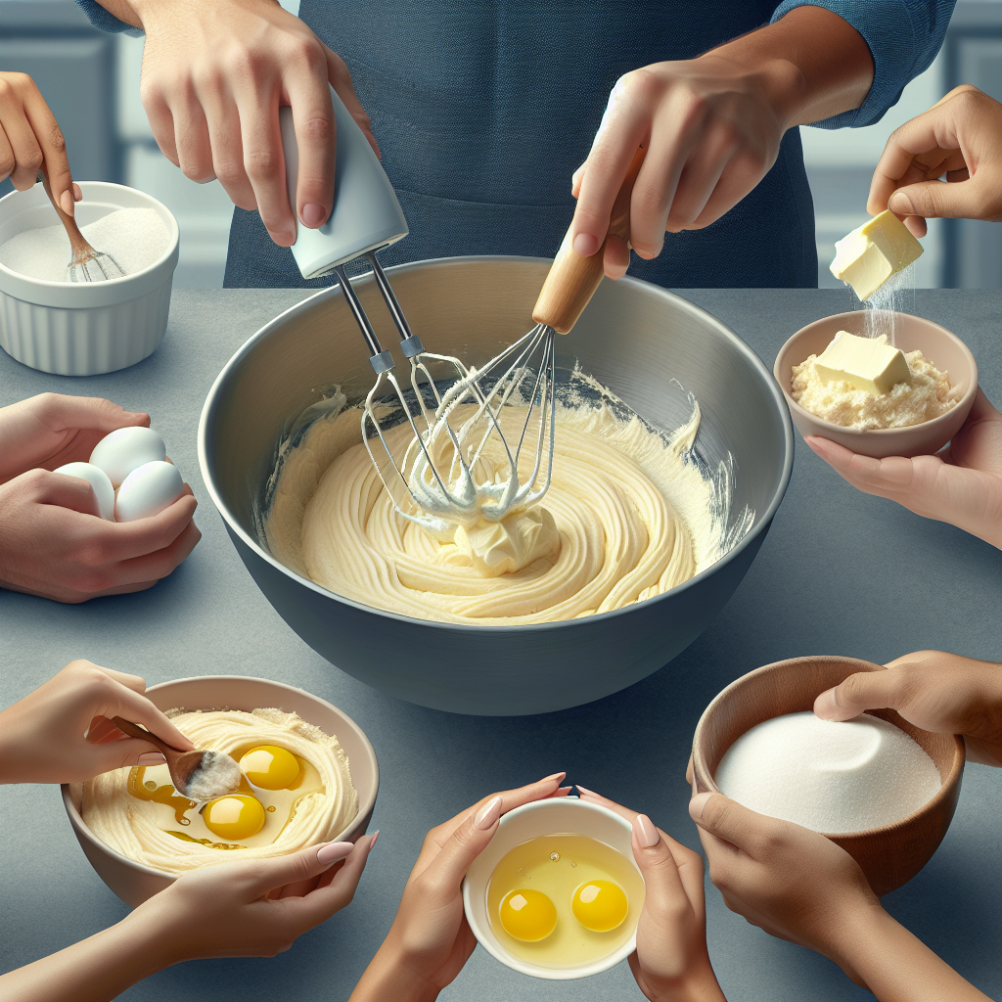
Cream butter, sugar, add eggs.
In a large bowl, cream together the softened butter and sugar using an electric mixer until light and fluffy. Add the eggs, one at a time, beating well after each addition. Stir in the vanilla extract.

Slide 7
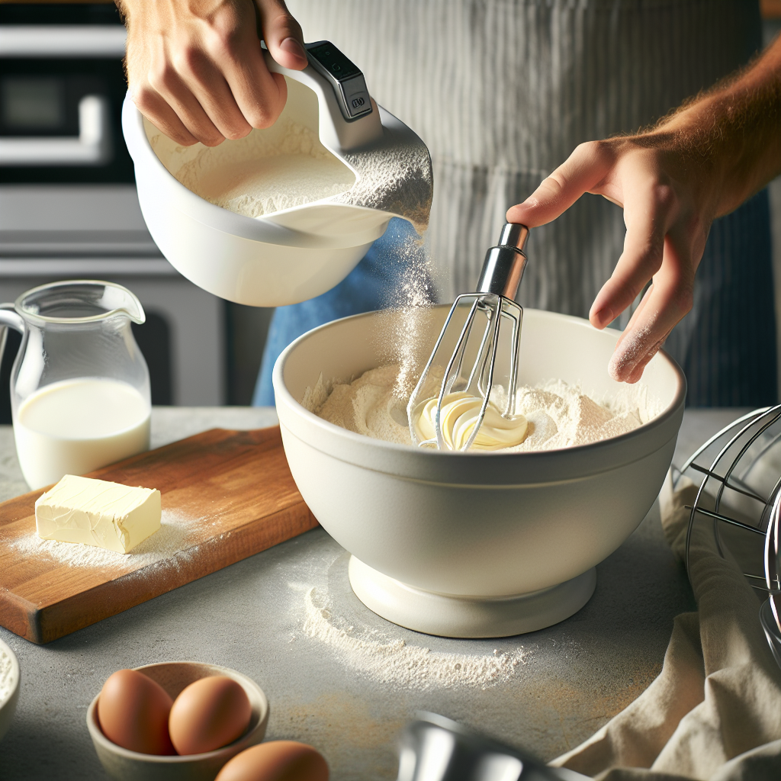
Mix flour, butter, milk gently.
Gradually add the flour mixture to the butter mixture, alternating with the milk, and begin by mixing on low speed. Mix until just combined; do not overmix.

Slide 8
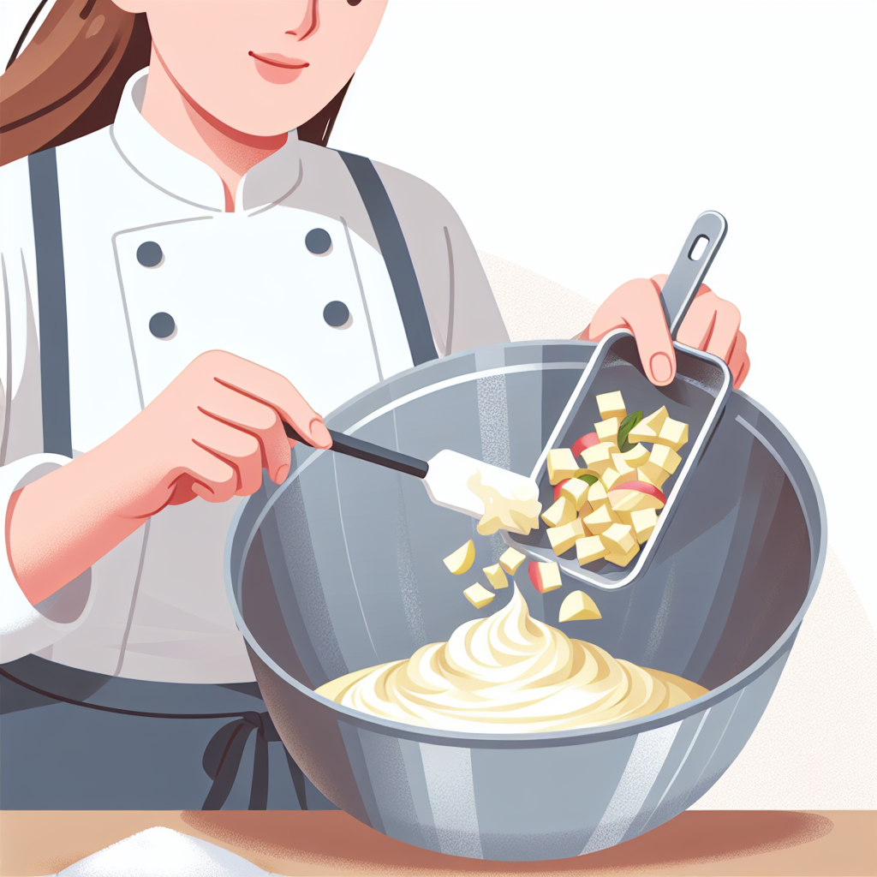
Fold apples into batter evenly.
Gently fold in the chopped apples until they are evenly distributed throughout the batter.

Slide 9
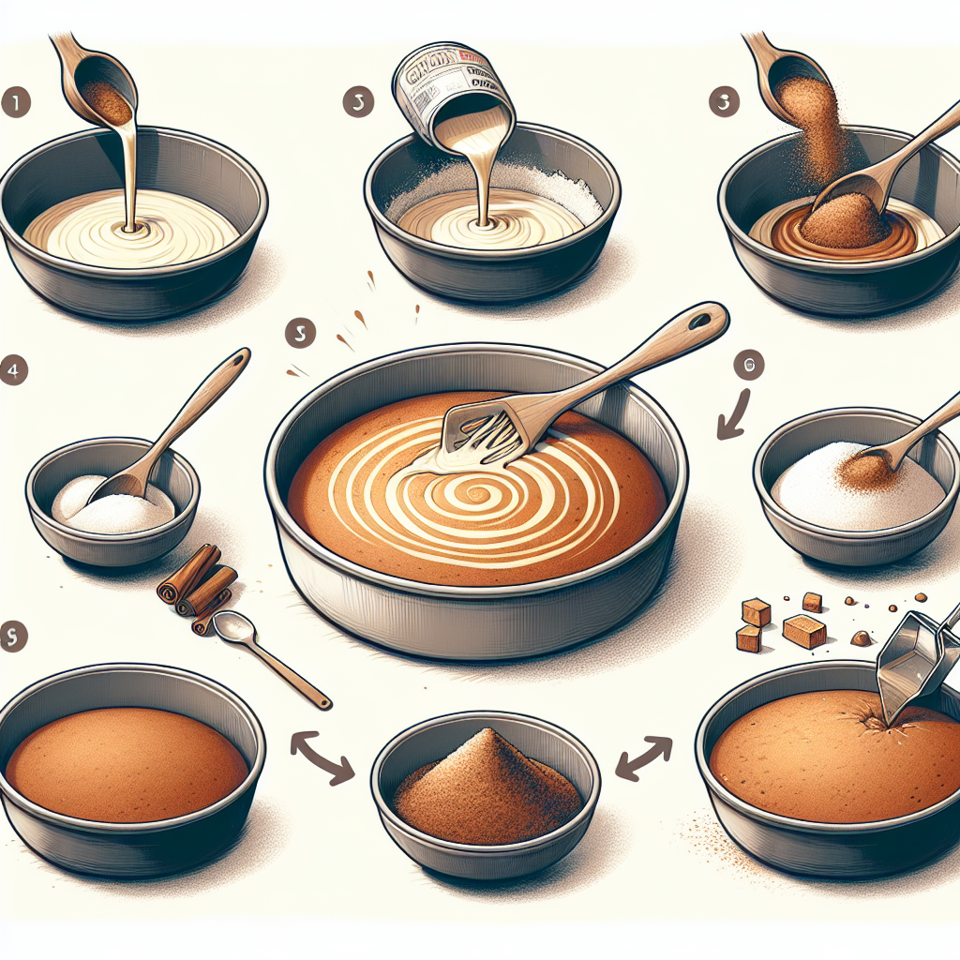
Sprinkle cinnamon-sugar on batter.
Pour the batter into the prepared cake pan. In a small bowl, mix together the ground cinnamon and brown sugar, then sprinkle this mixture over the top of the cake batter.

Slide 10

Bake until toothpick comes clean.
Bake in the preheated oven for about 40-45 minutes, or until a toothpick inserted into the center of the cake comes out clean.

Slide 11
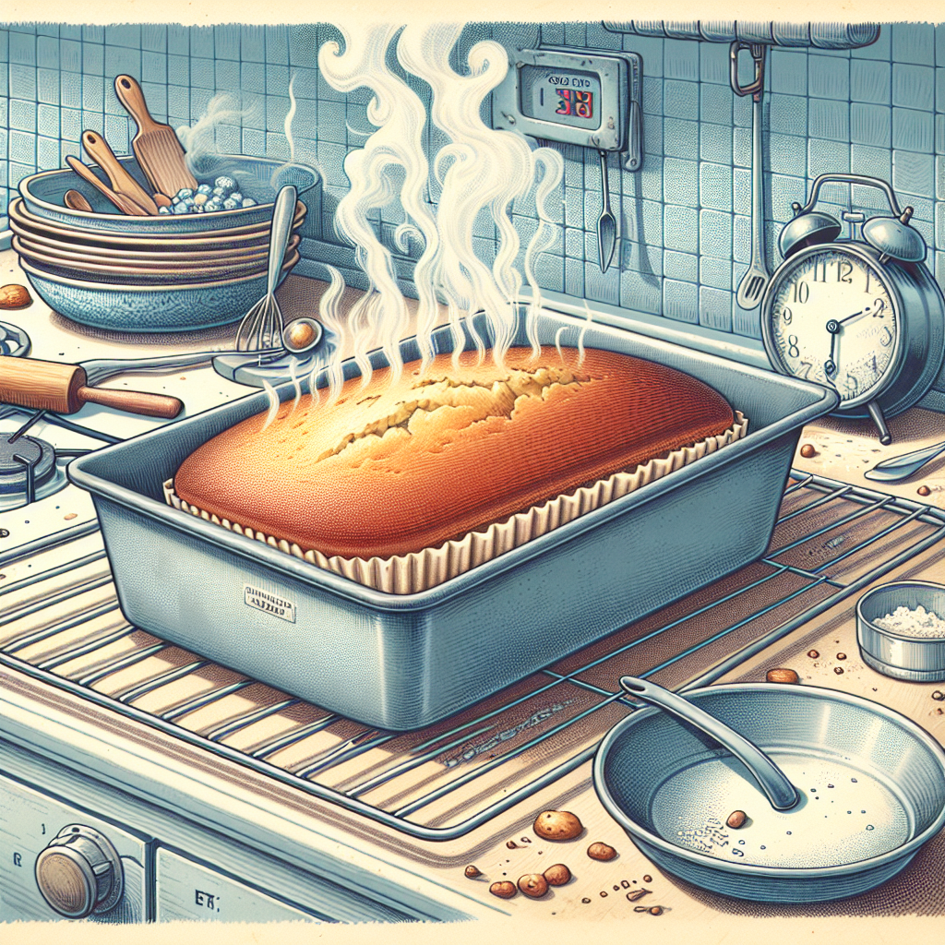
Cool cake in pan, then rack.
Allow the cake to cool in the pan for about 10 minutes, then transfer it to a wire rack to cool completely.

Slide 12
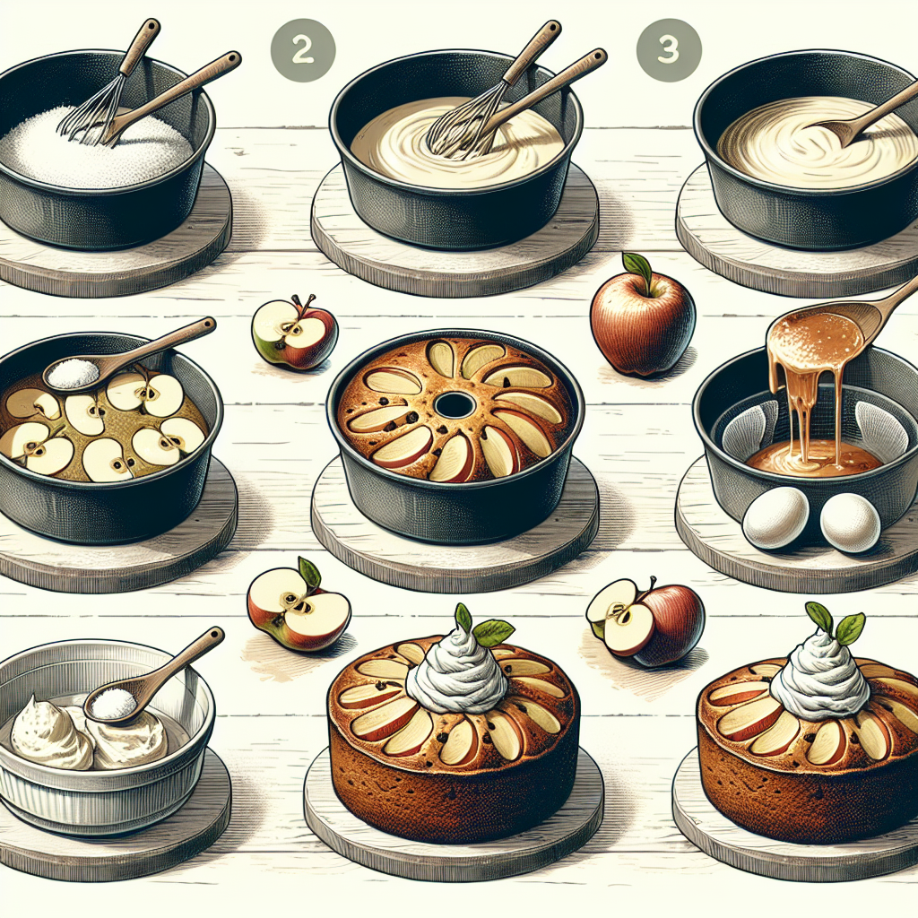
Delicious, moist apple cake dessert.
This apple cake is wonderfully moist and packed with flavor, perfect for a cosy afternoon snack or a delightful dessert. Enjoy it with a dollop of whipped cream or a scoop of vanilla ice cream for an extra special treat.

